Slide 1
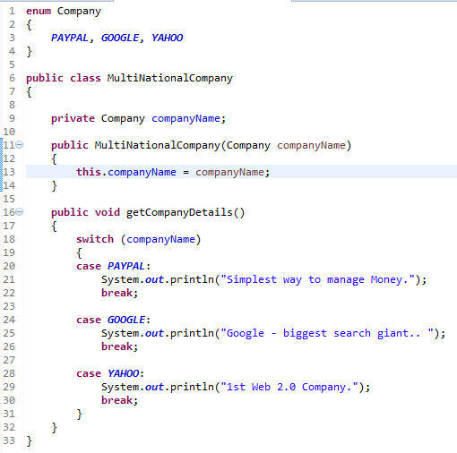
Java Enum
Enums are lists of constants. When you need a predefined list of values which do represent some kind of numeric or textual data, you should use an enum.
You should always use enums when a variable (especially a method parameter) can only take one out of a small set of possible values. Examples would be things like type constants (contract status: “permanent”, “temp”, “apprentice”).
All enums implicitly extend java.lang.Enum. Since Java does not support multiple inheritance, an enum cannot extend anything else.
Enum in Java are type-safe: Enum has there own name-space. It means your enum will have a type for example “Company” in below example and you can not assign any value other than specified in Enum Constants.
public enum Company {
PAYPAL, GOOGLE, YAHOO
}
Company companyName = Company.GOOGLE;
companyName = 1; // Compilation Error

Slide 2
Java Enum
Enum constants are implicitly static and final and can not be changed once created.
Enum can be safely compare using:
Switch-Case Statement
== Operator
.equals() method
Company eBay = Company.EBAY;
if(eBay == Company.EBAY)
{
log.info("enum in java can be compared using ==");
}
An enum specifies a list of constant values assigned to a type.
An enum can be declared outside or inside a class, but NOT in a method.
An enum declared outside a class must NOT be marked static, final , abstract, protected , or private.
The semicolon at the end of an enum declaration is optional. These are legal:
enum Foo { ONE, TWO, THREE}
enum Foo { ONE, TWO, THREE};

